Slide 1
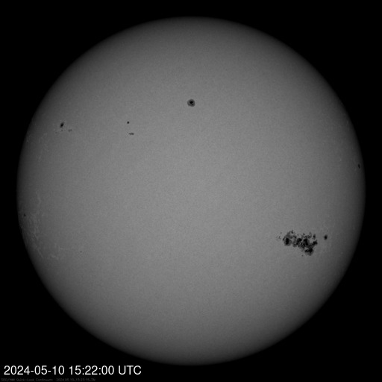
Geomagnetic Storm Watch Issued – May 11
G4
* No changes to the forecast since May 9 * A Geomagnetic Storm Watch has been issued for May 11, 2024 from the Space Weather Prediction Center A Coronal Mass Ejection (CME), or an eruption of solar material is expected to arrive at Earth late May 10 or early May 11, 2024. Area of impact will be primarily north of 45° latitude. Impacts: Satellite navigation (GPS) degraded or inoperable for several hours. HF (high frequency) radio transmission degraded or black out. Voltage control problems may be possible to local power grids. Aurora may be visible as far south as California to Alabama. More details as new information is made available.
Notes:
Backup Image Source: https://www.weather.gov/crh/

Slide 2
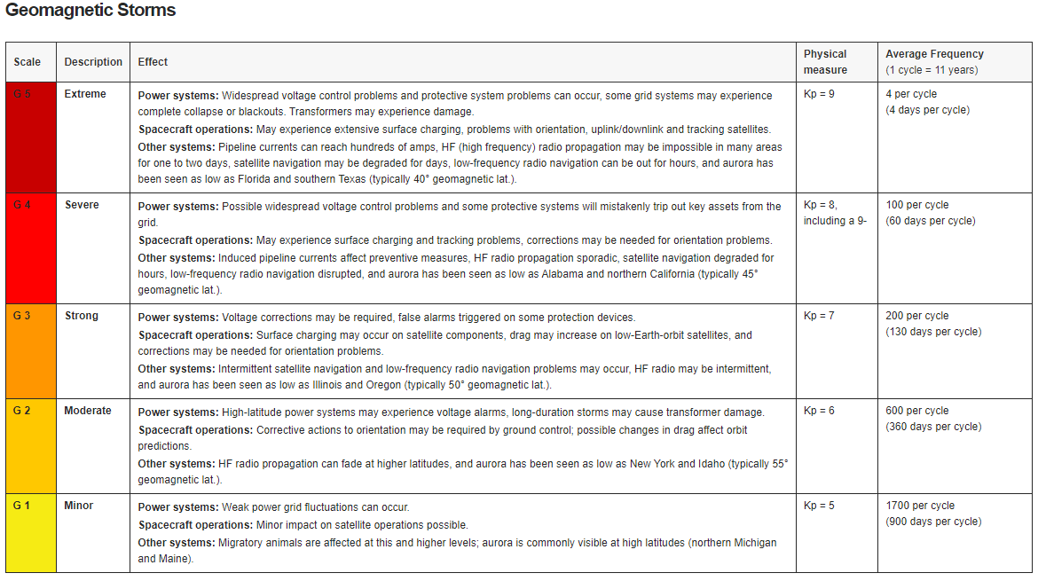
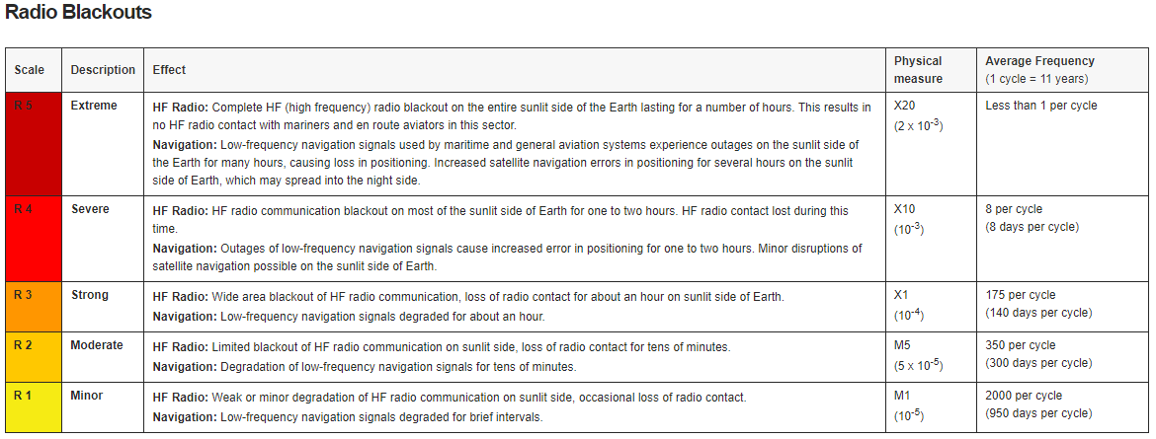
Scale Explanation and Impacts

