Slide 1



Adding Intensity Information to SPC Outlooks
Utilizing conditional intensity to better quantify probabilistic threat by severe weather intensity
Rich Thompson
Chief of Forecast Operations
Storm Prediction Center
Storm Prediction Center
Norman, OK
Notes:
Today we are discussing the upcoming changes to the Storm Prediction Center (SPC) Convective Outlooks, specifically the introduction of the Conditional Intensity Framework.
On the screen, you see a side-by-side comparison of a hypothetical outlook for April 17, 2025.
On the left is the traditional Operational Outlook you are used to. On the right is the new "Conditional Intensity Tornado Outlook." Notice this new framework allows us to convey intensity information at lower probabilities than in the past.

Slide 2

Key Takeaways
Outlook Categories Unchanged
Frequency of outlook areas will be the same as prior years.
ENH in 2025 will be an ENH in 2026.
Added Intensity Information
3 intensity categories for tornado and wind (2 for hail) to better reflect hazard intensities and potential impacts.
How this Helps You
Greater Intensity Potential (EF3+/3.5+” Hail/73+kt winds) now explicitly forecast within our outlooks
-No more trying to infer this information from our outlook text!
Storm Prediction Center
Norman, OK
Notes:
It is crucial to understand that the standard outlook categories—Marginal, Slight, Enhanced, Moderate, and High—are unchanged. An "Enhanced" risk in 2025 will mean the same thing in 2026. However, we will continue to deemphasize the words and put more focus on the colors and numbers. The frequency of these outlook areas should remain the same.
What is New: We are adding Intensity Information.
The Benefit: This addition allows us to highlight the "conditional potential" for serious impacts. We will now have multiple intensity levels available for Day 1, 2, and 3 forecasts.

Slide 3
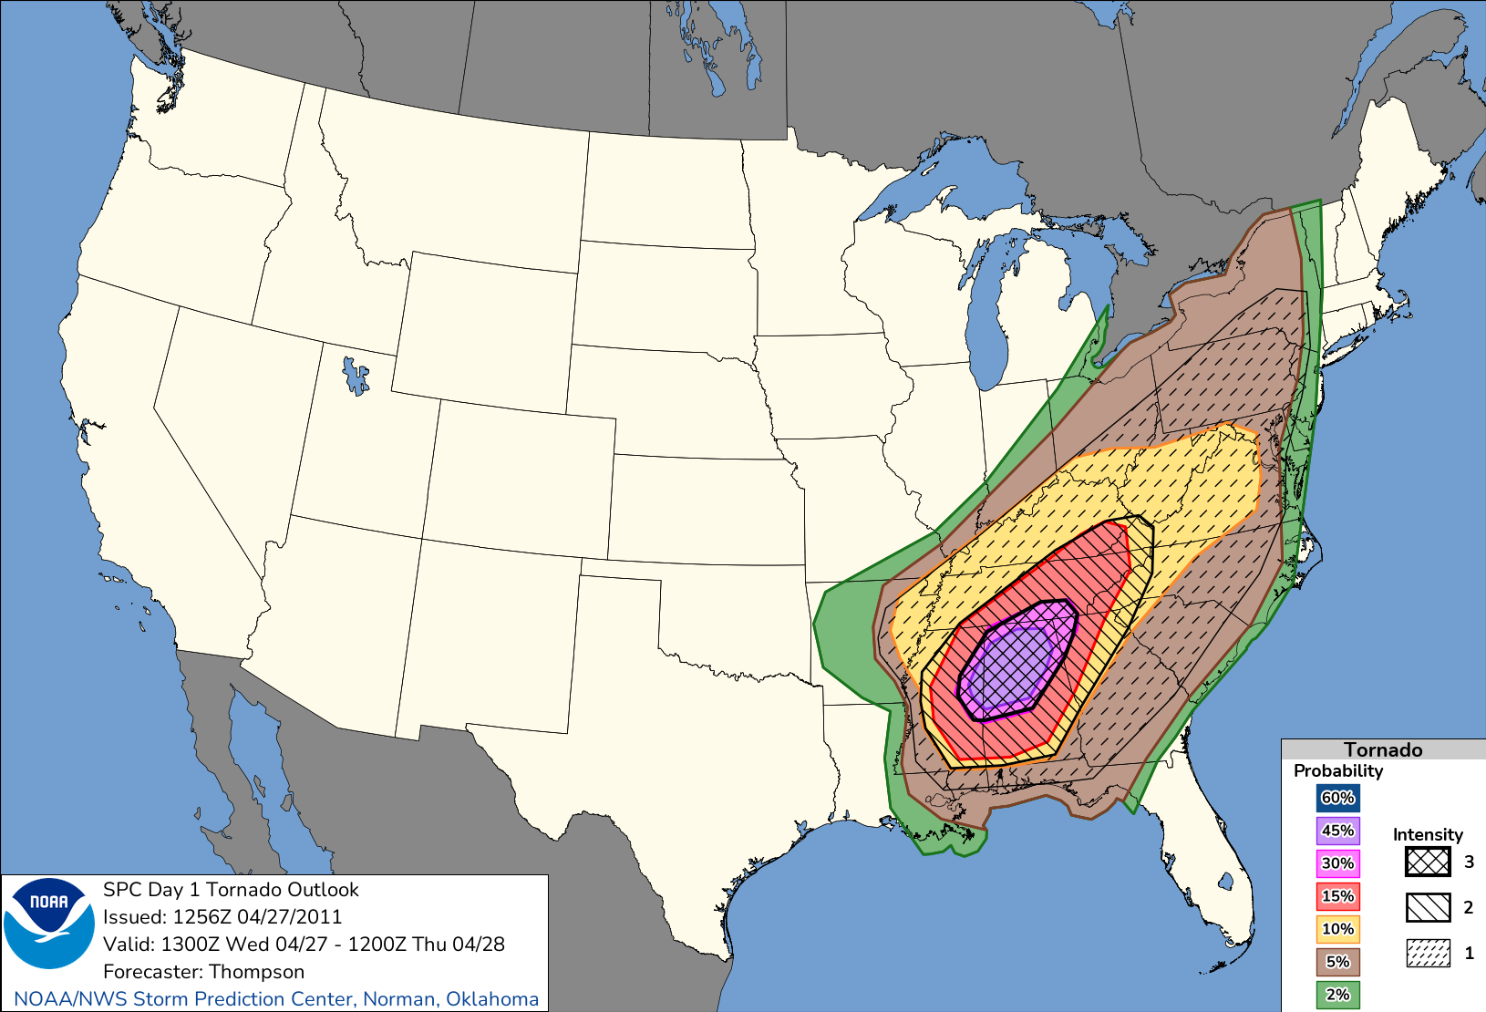
What if 27 April 2011 Looked Like This?
Intensity Level 1
(think of as EF2)
Intensity Level 2
(think of as EF3)
Intensity Level 3
(think of as EF4)
Storm Prediction Center
Norman, OK
Notes:
This is the April 27, 2011 Super Outbreak
CIG1 (Think EF2+).
CIG2 (Think EF3+).
CIG3. This indicates a "Historic Outbreak" potential, or what we should think of as EF4+ risk.
Clarity: This map clearly communicates the extreme nature of the risk in the center of the outlook area.

Slide 4
New: Conditional Intensities in SPC Outlooks
Key Change: You no longer need a 10% or greater probability area to highlight significant severe potential.
Methodology: Intensity forecasts are now based on storm environment and storm mode.
Definition: These intensities are conditional, meaning: “If a tornado occurs, what is the probability it will be EF2/EF3/EF4?”
Less Intense
More Intense
Mostly EF0-EF1
Reasonable Max EF2
Reasonable Max EF3
Reasonable Max EF4
No Intensity Drawn
Intensity Level 1
Intensity Level 2
Intensity Level 3
Storm Prediction Center
Norman, OK
Notes:
The Key Shift: You no longer need a 10% probability area to highlight significant potential.
"First Guess": We use storm environment and storm mode as a "first guess" to assign these intensity levels.
The Definition: The forecast answers this question: "If a tornado occurs, what is the probability it will be significant (EF2+)?".
The Climatology for EF2 tornadoes is around 15%. Therefore, a day with no sig area is implying the threat for significant tornadoes is less than climatology.

Slide 5
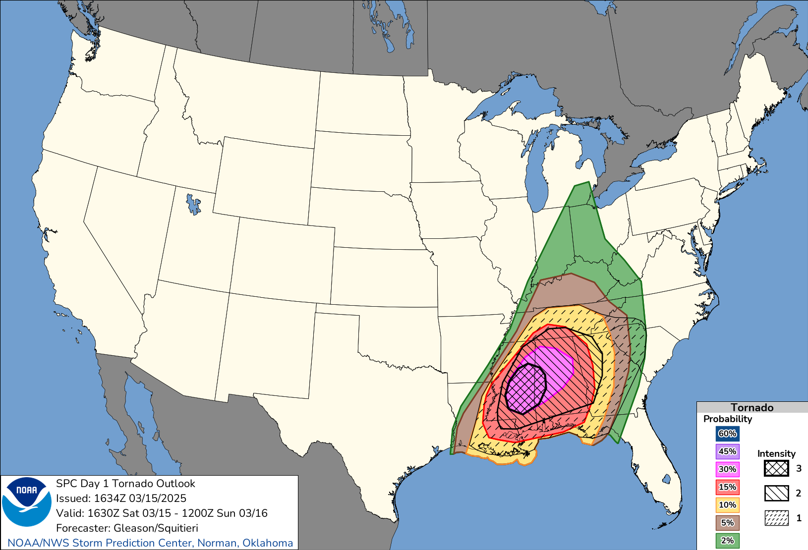
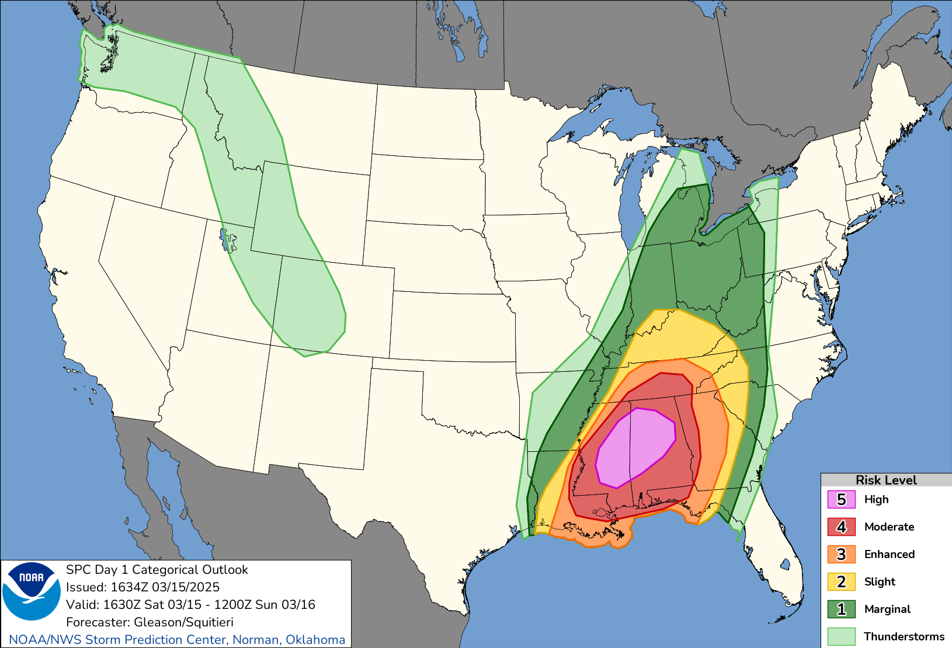
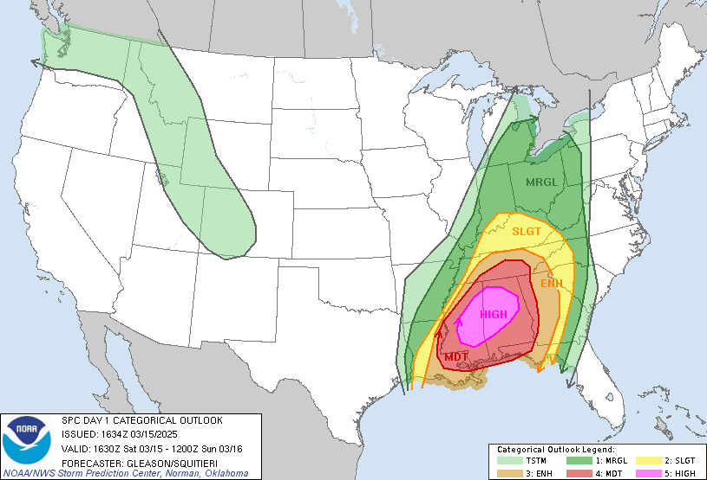
6 Year Project
We have been doing this experimentally for over 6 years
Since 2019 in the HWT
SPC forecasters have been creating these conditional intensities internally since late 2021.
We have proven skill in the ability to discriminate the intensity levels
15 March 2025
EF3 EF4
Storm Prediction Center
Norman, OK
Notes:
It is crucial to understand that the standard outlook categories—Marginal, Slight, Enhanced, Moderate, and High—are unchanged. An "Enhanced" risk in 2025 will mean the same thing in 2026. However, we will continue to deemphasize the words and put more focus on the colors and numbers. The frequency of these outlook areas should remain the same.
What is New: We are adding Intensity Information.
The Benefit: This addition allows us to highlight the "conditional potential" for serious impacts. We will now have multiple intensity levels available for Day 1, 2, and 3 forecasts.

Slide 6



Why the Change?
Intensity
Why this creates confusion
The “Binary” Problem
Current “SIG” treats EF2 and EF5 tornadoes the same.
Result: No detail provided about higher-end events.
The “Coverage” Problem
10% “SIG” tornado areas with an ENH categorical outlook incorrectly implies all tornadoes will be EF2+.
Mathematically blocked from sharing intensity information when coverage is <10%.
Current “Significant” Definition
Tornado: EF2+
Wind: 65+ kts
Hail: 2"+
Intensity requires 10% coverage
Storm Prediction Center
Norman, OK
Notes:
Current Definitions: Currently, we define "Significant" severe weather as EF2+ tornadoes, 65+ knot winds, or 2+ inch hail. Crucially, displaying this intensity currently requires a 10% coverage probability.
The "Binary Trap": This creates confusion. We call it the "Binary Trap" because the current "SIG" label treats an EF2 tornado exactly the same as an EF5 tornado—there is no distinction for higher-end events.
The "Coverage Trap": Furthermore, if we have a high-intensity environment but low coverage (under 10%), we are mathematically blocked from sharing that intensity information with the public.

Slide 7

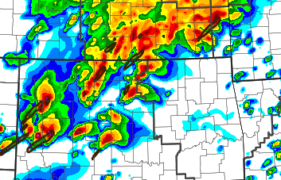
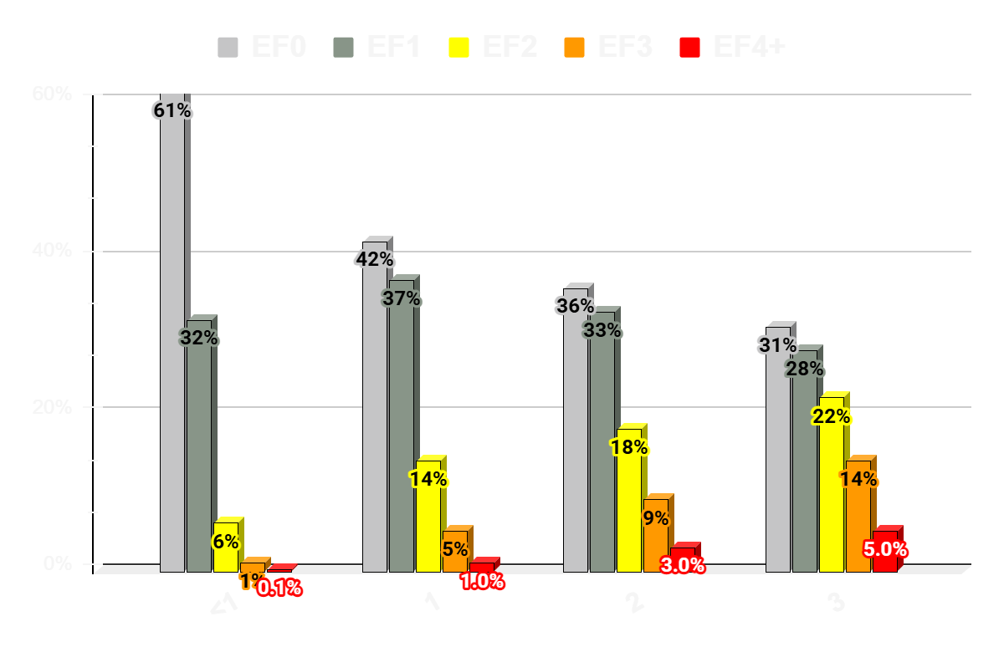
From Probability to Expected Outcomes
[ Storm Environment ] + [ Storm Mode ] → [ Intensity Distribution ]
e.g., STP values
e.g., Supercells
e.g., estimate number of tornadoes at different intensities
Intensity Level
Storm Prediction Center
Norman, OK
Notes:
"Essentially, we are making official what SPC has been doing implicitly for years. We are moving away from simple 'Yes/No' severe weather detection. Instead, we are looking at the specific combination of storm environment and storm mode—like supercells in a high STP area—to forecast a 'distribution' of events. This allows us to predict the actual intensity and number of tornadoes, rather than just the probability of one occurring."

Slide 8
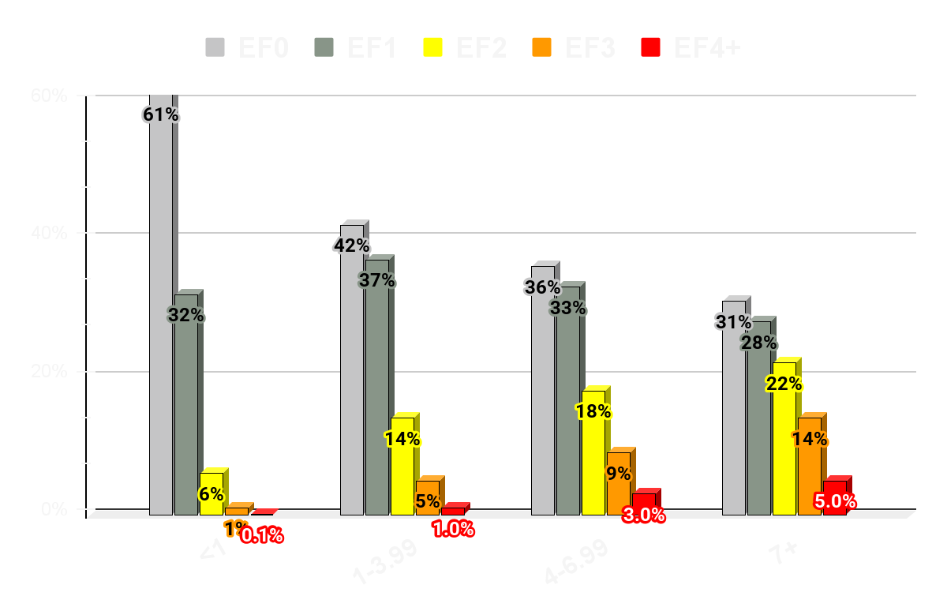
Conditional Intensity Groups (CIG)
Tornado
20 years of tornado intensities by environment
Define conditional intensity groups (CIG) based on expected tornado distribution
STP <1 : 7% EF2+
STP 1-4 : 20% EF2+ (CIG1)
STP 4-7 : 30% EF2+ (CIG2)
STP 7+ : 40% EF2+ (CIG3)
EF2+
7%
20%
30%
~40%
STP (effective layer)
Storm Prediction Center
Norman, OK
Notes:
Defining CIGs: We have analyzed 20 years of tornado intensities to create Conditional Intensity Groups (CIGs).
The Tiers:
<CIG1 (Below Climo): The vast majority of tornadoes here are EF0 or EF1.
CIG1 (Above Climo): Here, we see a jump. The likelihood of EF3+ tornadoes is 5.5 times higher than the baseline.
CIG2 (Double Climo): The risk doubles again. EF3+ likelihood is 11x the baseline.
CIG3 (Historic Outbreak): In these environments, nearly 40% of tornadoes are significant, and the risk of EF4+ events is 37 times higher than usual.

Slide 9
CIG = Intensity Level
Scientifically, these are Conditional Intensity Groups (CIG). However, simpler communication will be “Intensity Level”.
SPC Communication may occasionally use this terminology due to 4 years of its use and development with this terminology.
CIG<1 = No Intensity Highlights
CIG1 = Intensity Level 1
CIG2 = Intensity Level 2
CIG3 = Intensity Level 3
Storm Prediction Center
Norman, OK
Notes:
Defining CIGs: We have analyzed 20 years of tornado intensities to create Conditional Intensity Groups (CIGs).
The Tiers:
<CIG1 (Below Climo): The vast majority of tornadoes here are EF0 or EF1.
CIG1 (Above Climo): Here, we see a jump. The likelihood of EF3+ tornadoes is 5.5 times higher than the baseline.
CIG2 (Double Climo): The risk doubles again. EF3+ likelihood is 11x the baseline.
CIG3 (Historic Outbreak): In these environments, nearly 40% of tornadoes are significant, and the risk of EF4+ events is 37 times higher than usual.

Slide 10
Target Reference Distributions
Tornado
More Intense Tornadoes Become More Frequent As Intensity Level Increases
EF3+ Tornadoes cause the vast majority of fatalities (88%) and injuries (75%)
EF3+
1%
6%
12%
~20%
Intensity Level
Storm Prediction Center
Norman, OK
Notes:
Defining CIGs: We have analyzed 20 years of tornado intensities to create Conditional Intensity Groups (CIGs).
The Tiers:
<CIG1 (Below Climo): The vast majority of tornadoes here are EF0 or EF1.
CIG1 (Above Climo): Here, we see a jump. The likelihood of EF3+ tornadoes is 5.5 times higher than the baseline.
CIG2 (Double Climo): The risk doubles again. EF3+ likelihood is 11x the baseline.
CIG3 (Historic Outbreak): In these environments, nearly 40% of tornadoes are significant, and the risk of EF4+ events is 37 times higher than usual.

Slide 11
What Do We Really Mean by Conditional Tornado Intensity?
Forecast is a Reasonable Max Intensity Based on Environment and Storm Mode
More Simply Communicated
Intensity Level <1: Mostly EF0-EF1
Intensity Level 1 : Reasonable Max EF2
Intensity Level 2 : Reasonable Max EF3
Intensity Level 3 : Reasonable Max EF4
Storm Prediction Center
Norman, OK
Notes:
Defining CIGs: We have analyzed 20 years of tornado intensities to create Conditional Intensity Groups (CIGs).
The Tiers:
<CIG1 (Below Climo): The vast majority of tornadoes here are EF0 or EF1.
CIG1 (Above Climo): Here, we see a jump. The likelihood of EF3+ tornadoes is 5.5 times higher than the baseline.
CIG2 (Double Climo): The risk doubles again. EF3+ likelihood is 11x the baseline.
CIG3 (Historic Outbreak): In these environments, nearly 40% of tornadoes are significant, and the risk of EF4+ events is 37 times higher than usual.

Slide 12
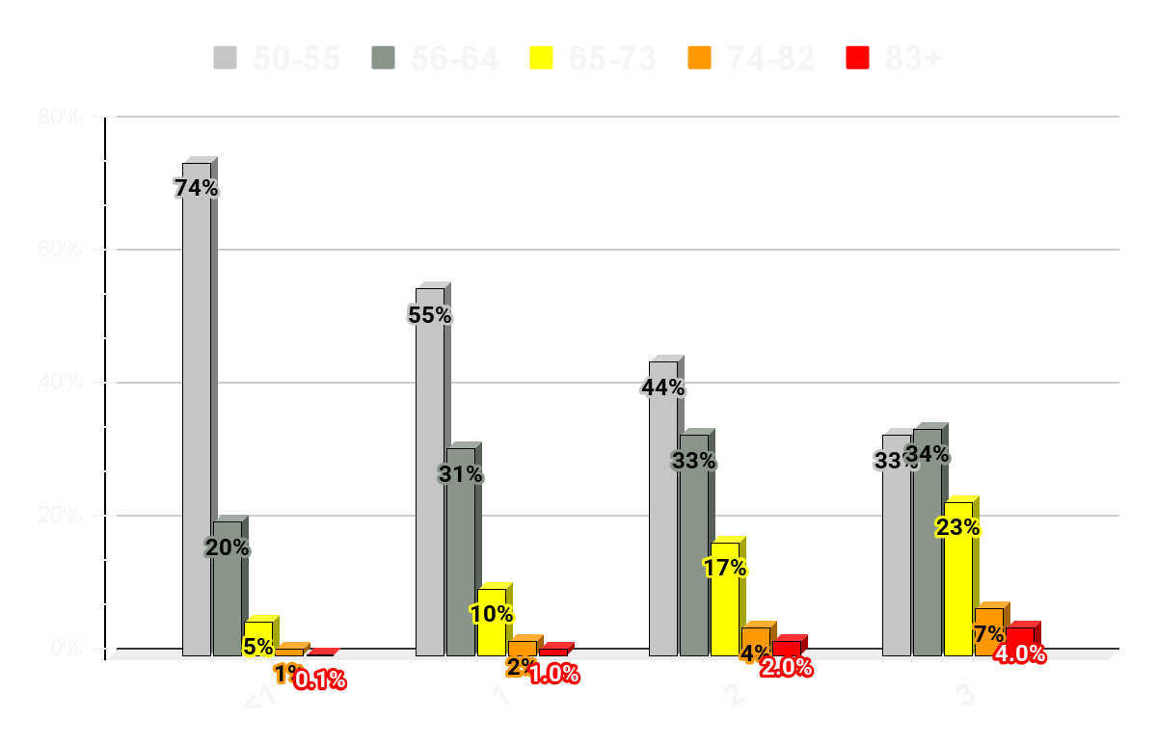
Target Reference Distribution
Wind
Combination of historical SPC outlook performance and environment to develop target reference distribution.
No Intensity Highlights: Mostly <64 kt winds
Intensity Level 1: All storm modes, peak gusts 65+ knot
Intensity Level 2: Bow echo and derecho possible
Intensity Level 3: High-end derecho (usually ongoing)
65+ kts
6%
13%
23%
34%
Intensity Level
Storm Prediction Center
Norman, OK
Notes:
Wind Groups: We apply this same logic to wind.
<CIG1: Mostly winds below 64 knots.
CIG1 (Above Climo): All storm modes, peak gusts 64+ knots.
CIG2: Significant events like Bow Echos and Derechos.
CIG3: High-end Derechos (usually ongoing events).

Slide 13
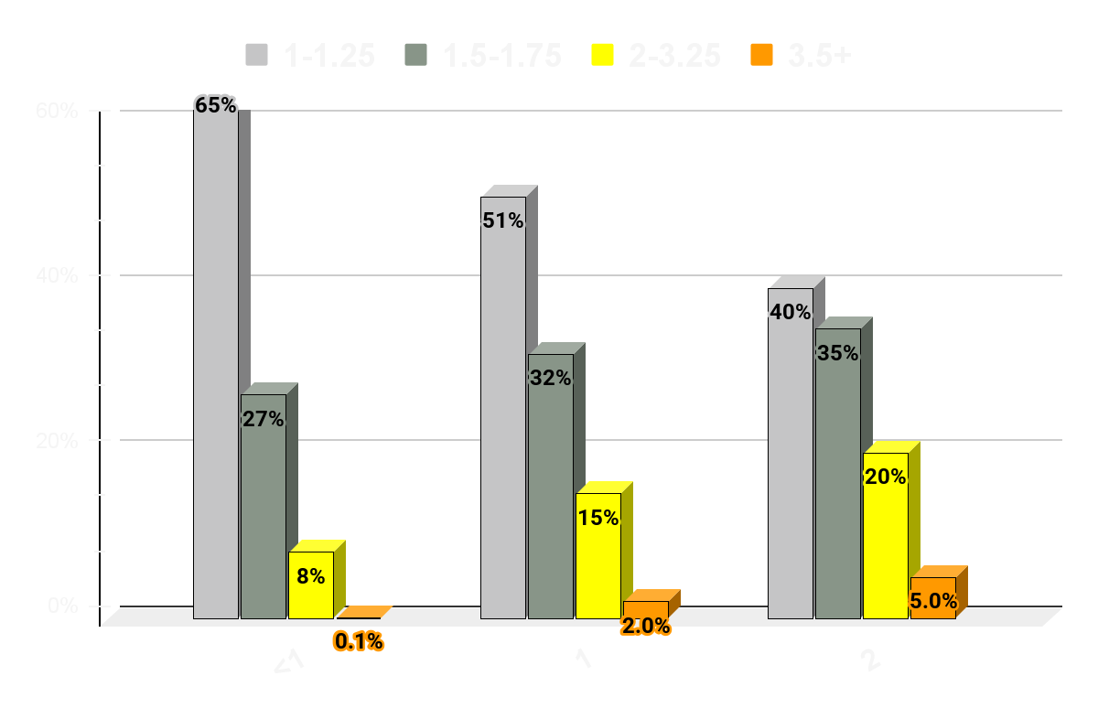
Target Reference Distribution
Hail
Combination of historical SPC outlook performance and environment (SHP) to develop target reference distribution.
<CIG1: Mostly <2”
CIG1: Supercell environment with largest hail >2”
CIG2: Long-Track Supercells - largest hail >3.5”
2+ inch
8%
17%
25%
Intensity Level
Storm Prediction Center
Norman, OK

Slide 14
SPC Conditional Intensity Outlooks
Tornado
60%
45%
30%
CIG 0
CIG 1
CIG 2
Simple graphic x/y axis
15%
Increasing impacts
10%
30%
20%
5%
7%
Outlook Probabilities
2%
No highlights
CIG1
CIG2
CIG3
Conditional Intensity
Storm Prediction Center
Norman, OK
Notes:
Low Intensity but high coverage, will have some impact, but not enough to warrant a high risk. High intensity, but low coverage may have significant impact, but likely not widespread enough to warrant a high risk. You need both high intensity and high coverage for the impacts to be substantial enough to support a moderate/high risk.

Slide 15
SPC Conditional Intensity Outlooks
Tornado
Widespread
Numerous
CIG 0
CIG 1
CIG 2
Simple graphic x/y axis
Scattered
Increasing impacts
Widely Scattered
30%
20%
7%
Coverage
Isolated
Low-End Severe
Significant
Intense
Extreme
Intensity
Storm Prediction Center
Norman, OK
Notes:
Low Intensity but high coverage, will have some impact, but not enough to warrant a high risk. High intensity, but low coverage may have significant impact, but likely not widespread enough to warrant a high risk. You need both high intensity and high coverage for the impacts to be substantial enough to support a moderate/high risk.

Slide 16
SPC Tornado Outlook Combinations
Late 2014-2025
Starting in 2026
60% | 5 HIGH | 5 HIGH
45% | 5 HIGH | 5 HIGH
30% | 4 MDT | 5 HIGH
15% | 3 ENH | 4 MDT
10% | 3 ENH | 3 ENH
5% | 2 SLGT | not used
2% | 1 MRGL | not used
 | No Sig | SIG
60% | 3 ENH | 5 HIGH | 5 HIGH | 5 HIGH
45% | 3 ENH | 4 MDT | 5 HIGH | 5 HIGH
30% | 3 ENH | 4 MDT | 5 HIGH | 5 HIGH
15% | 3 ENH | 3 ENH | 4 MDT | 4 MDT
10% | 2 SLGT | 3 ENH | 3 ENH | 3 ENH
5% | 2 SLGT | 2 SLGT | 3 ENH | not used
2% | 1 MRGL | 1 MRGL | 2 SLGT | not used
 | <CIG1 | CIG1 | CIG2 | CIG3
Storm Prediction Center
Norman, OK
Notes:
Old way - 3 ways to get enhanced. New way (9 ways to get to enhanced)
Old way - no way to show high coverage but low intensity events (is 45% coverage of mostly weak tornadoes worthy of a high risk?)

Slide 17
SPC Wind Outlook Combinations
Late 2014-2025
Starting in 2026
90% | 3 ENH | 4 MDT | 5 HIGH | 5 HIGH
75% | 3 ENH | 4 MDT | 5 HIGH | 5 HIGH
60% | 3 ENH | 4 MDT | 5 HIGH | 5 HIGH
45% | 3 ENH | 3 ENH | 4 MDT | 5 HIGH
30% | 2 SLGT | 3 ENH | 3 ENH | not used
15% | 2 SLGT | 2 SLGT | 3 ENH | not used
5% | 1 MRGL | 1 MRGL | 2 SLGT | not used
 | <CIG1 | CIG1 | CIG2 | CIG3
60% | 4 MDT | 5 HIGH
45% | 3 ENH | 4 MDT
30% | 3 ENH | 3 ENH
15% | 2 SLGT | 2 SLGT
5% | 1 MRGL | not used
 | No Sig | SIG
Storm Prediction Center
Norman, OK
Notes:
Old way - 3 ways to get enhanced. New way (8 ways to get to enhanced)
Old way - no way to show high coverage but low intensity events (is 60% coverage of mostly 58-70 mph winds worthy of a moderate?)

Slide 18
SPC Hail Outlook Combinations
Late 2014-2025
Starting in 2026
60% | 4 MDT | 4 MDT
45% | 3 ENH | 4 MDT
30% | 3 ENH | 3 ENH
15% | 2 SLGT | 2 SLGT
5% | 1 MRGL | not used
 | No Sig | SIG
60% | 3 ENH | 4 MDT | 4 MDT
45% | 3 ENH | 3 ENH | 4 MDT
30% | 2 SLGT | 3 ENH | 3 ENH
15% | 2 SLGT | 2 SLGT | 3 ENH
5% | 1 MRGL | 1 MRGL | 2 SLGT
 | <CIG1 | CIG1 | CIG2
Storm Prediction Center
Norman, OK
Notes:
Old way - 3 ways to get enhanced. New way (6 ways to get to enhanced)
Old way - no way to show high coverage but low intensity events (is 60% coverage of mostly 1 inch hail worthy of a moderate?)

Slide 19
SPC Day 3 Outlook Combinations
Late 2014-2025
Starting in 2026
45% + SIG | 4 MDT
45% | 3 ENH
30% + SIG | 3 ENH
30% | 3 ENH
15% + SIG | 2 SLGT
15% | 2 SLGT
5% | 1 MRGL
60% | 3 ENH | 4 MDT | 4 MDT
45% | 3 ENH | 3 ENH | 4 MDT
30% | 2 SLGT | 3 ENH | 3 ENH
15% | 2 SLGT | 2 SLGT | 3 ENH
5% | 1 MRGL | 1 MRGL | 2 SLGT
 | <CIG1 | CIG1 | CIG2
Storm Prediction Center
Norman, OK
Notes:
Old way - 3 ways to get enhanced. New way (6 ways to get to enhanced)
Old way - no way to show high coverage but low intensity events

Slide 20
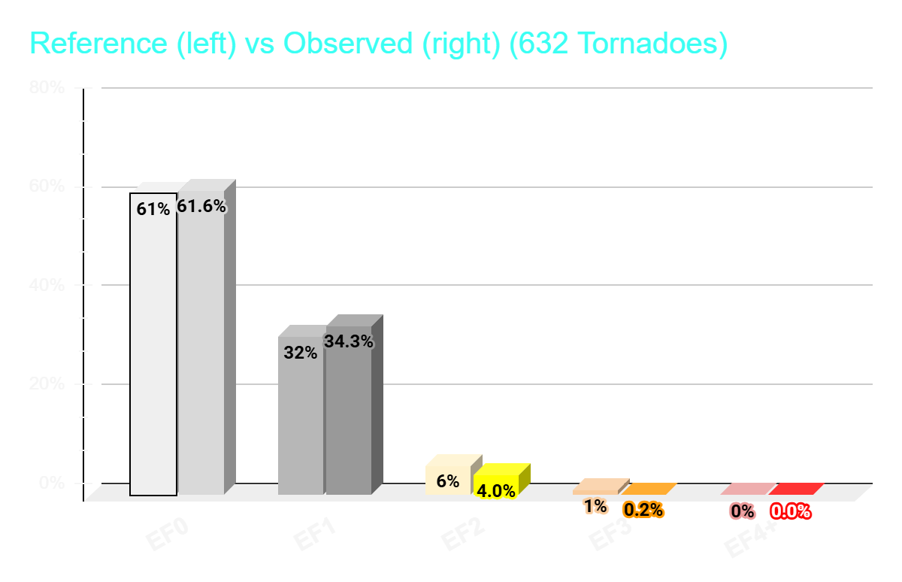
2025 Verification - No Intensity Area
Storm Prediction Center
Norman, OK
Notes:
This is a great forecast outcome, but not all are this close to being perfect. However, most bigger events are reasonably close.

Slide 21
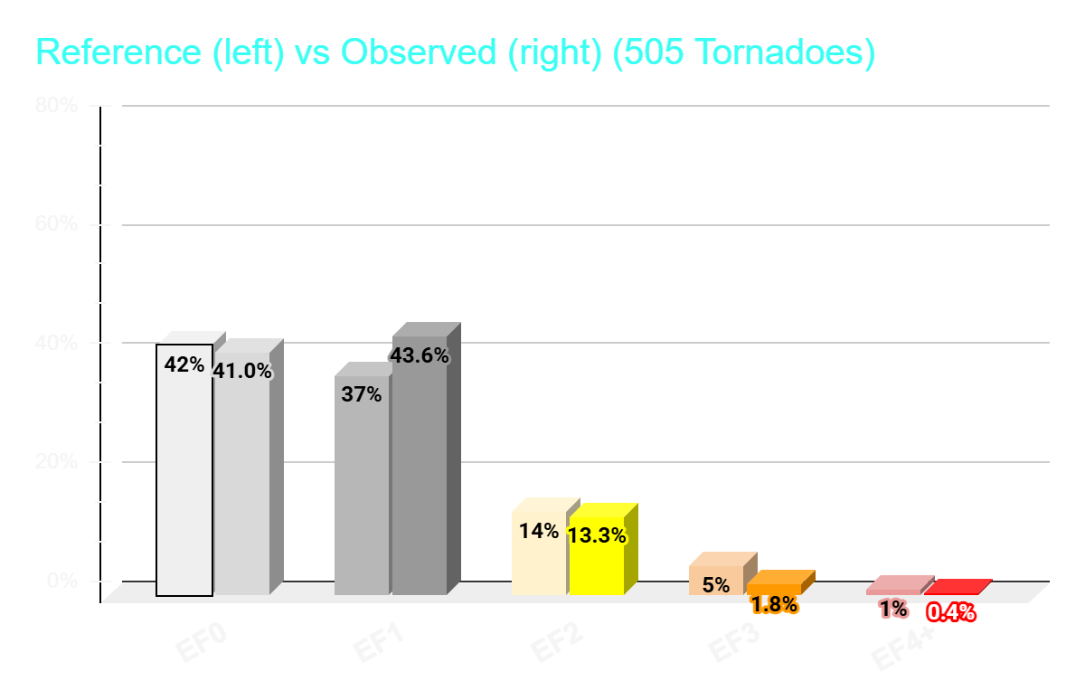
2025 Verification - CIG1
Storm Prediction Center
Norman, OK
Notes:
This is a great forecast outcome, but not all are this close to being perfect. However, most bigger events are reasonably close.

Slide 22
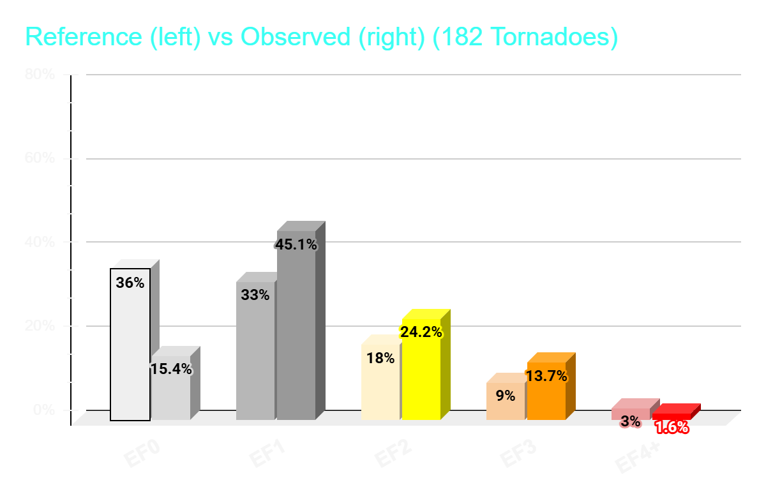
2025 Verification - CIG2
Storm Prediction Center
Norman, OK
Notes:
This is a great forecast outcome, but not all are this close to being perfect. However, most bigger events are reasonably close.

Slide 23
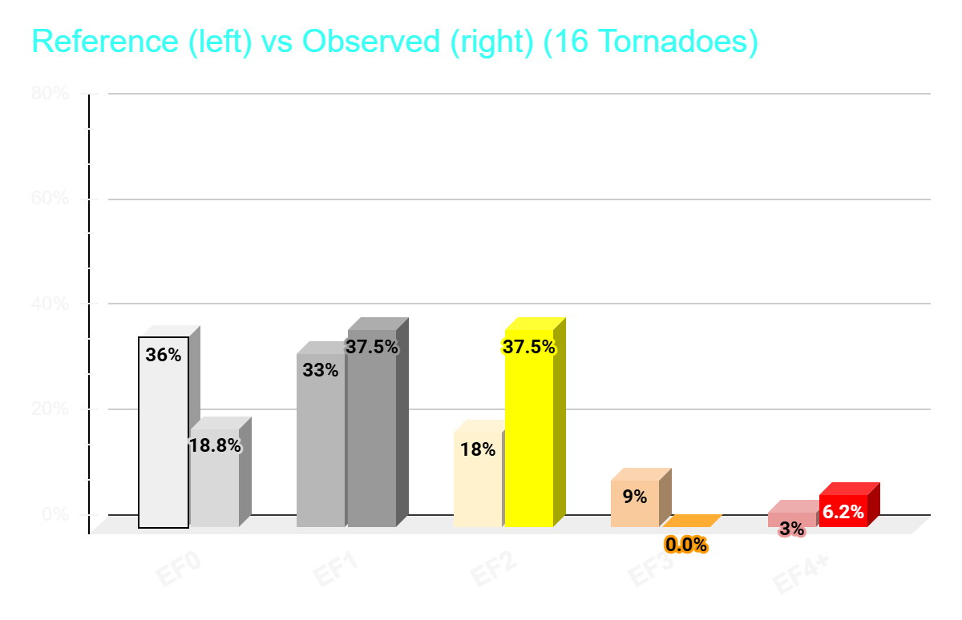
2025 Verification - CIG3
Storm Prediction Center
Norman, OK
Notes:
This is a great forecast outcome, but not all are this close to being perfect. However, most bigger events are reasonably close.

Slide 24
2025 Examples of Conditional Intensity Outlooks
On the left - SPC operational outlook
On the right - Conditional Intensity forecasts produced in real time
Reports during the forecast period are plotted on each graphic
Storm Prediction Center
Norman, OK
Notes:
We will now look at how these forecasts appear in real-time operations versus the operational outlooks.

Slide 25
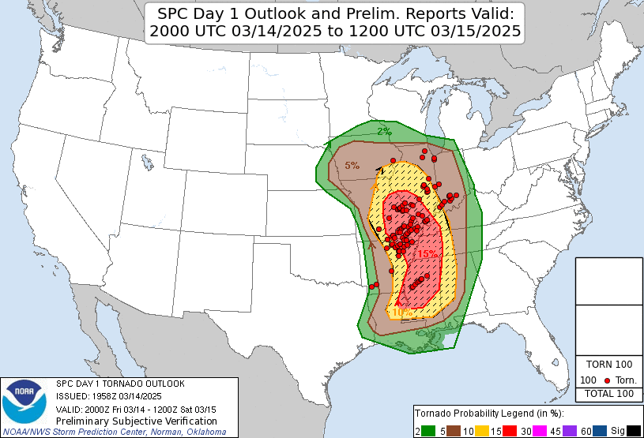
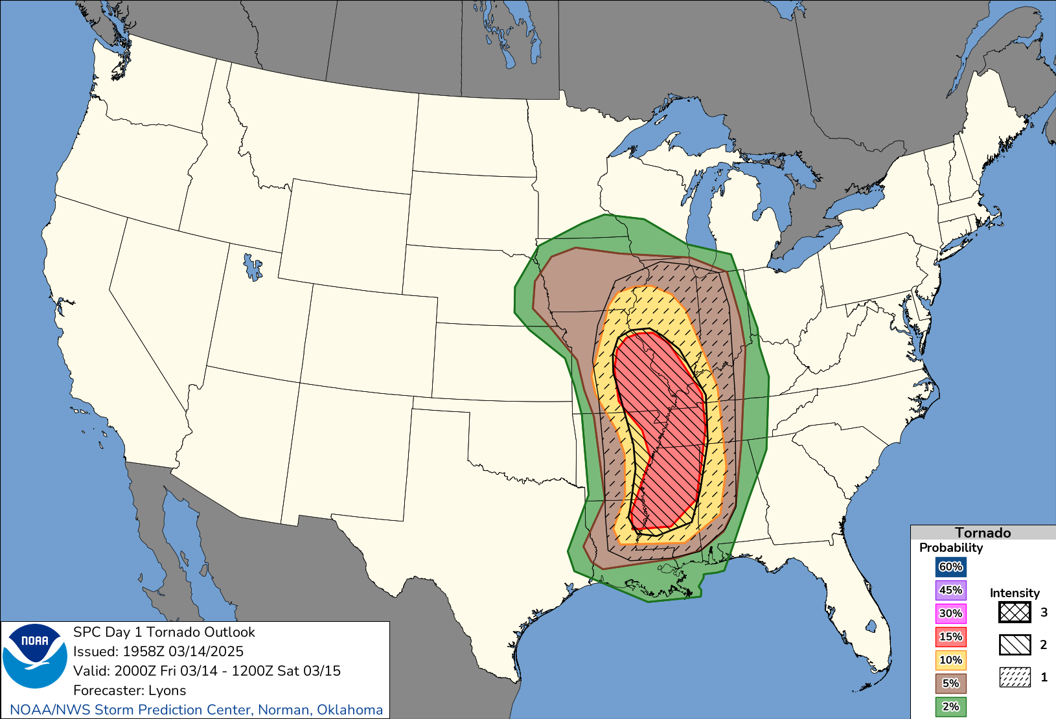
14 March 2025 - Tornado Outlook
Operational
Conditional Intensity
EF2 (In 5% or 2%) EF3 EF4+
Storm Prediction Center
Norman, OK

Slide 26
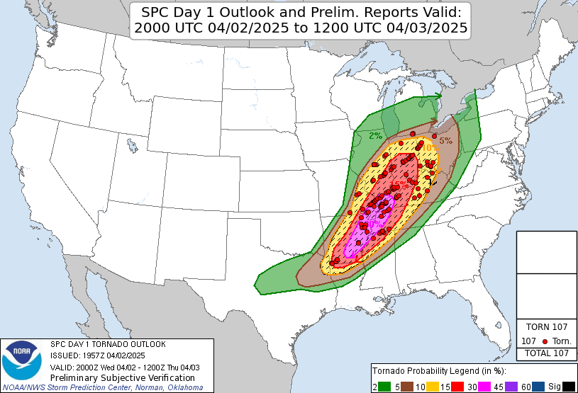
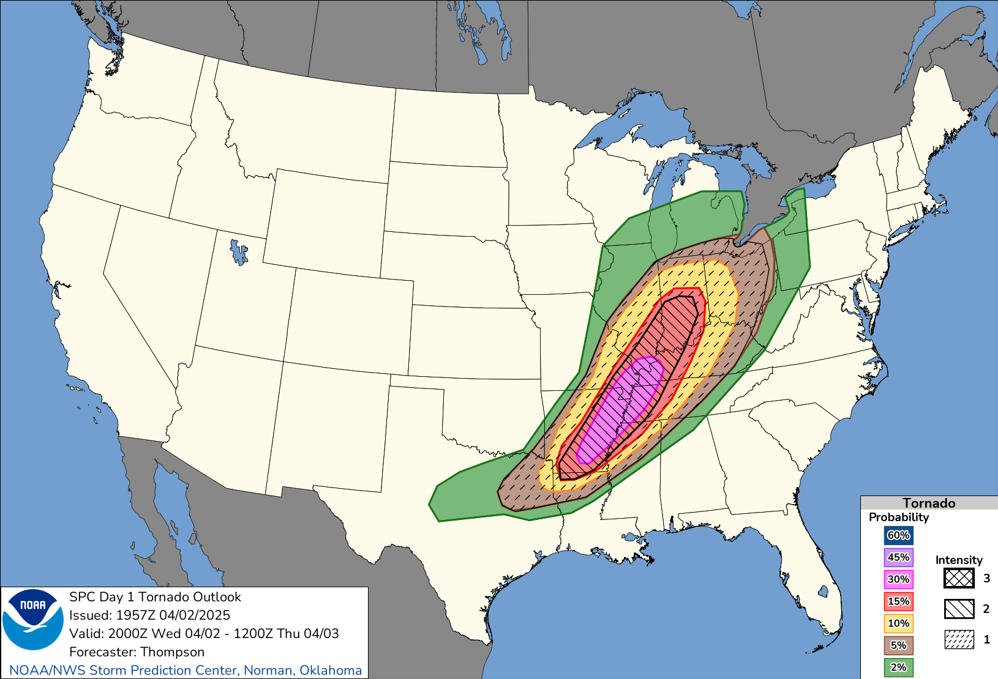
2 April 2025 - Tornado Outlook
Operational
Conditional Intensity
EF2 (In 5% or 2%) EF3 EF4+
Storm Prediction Center
Norman, OK

Slide 27
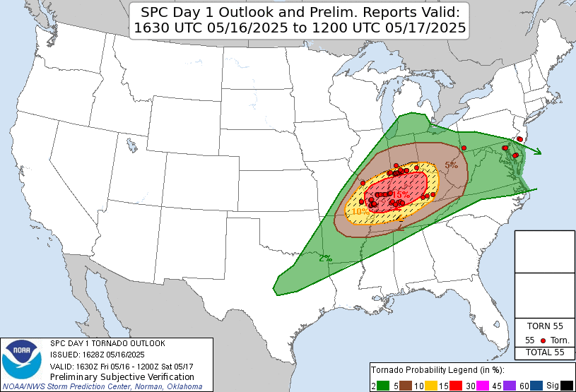
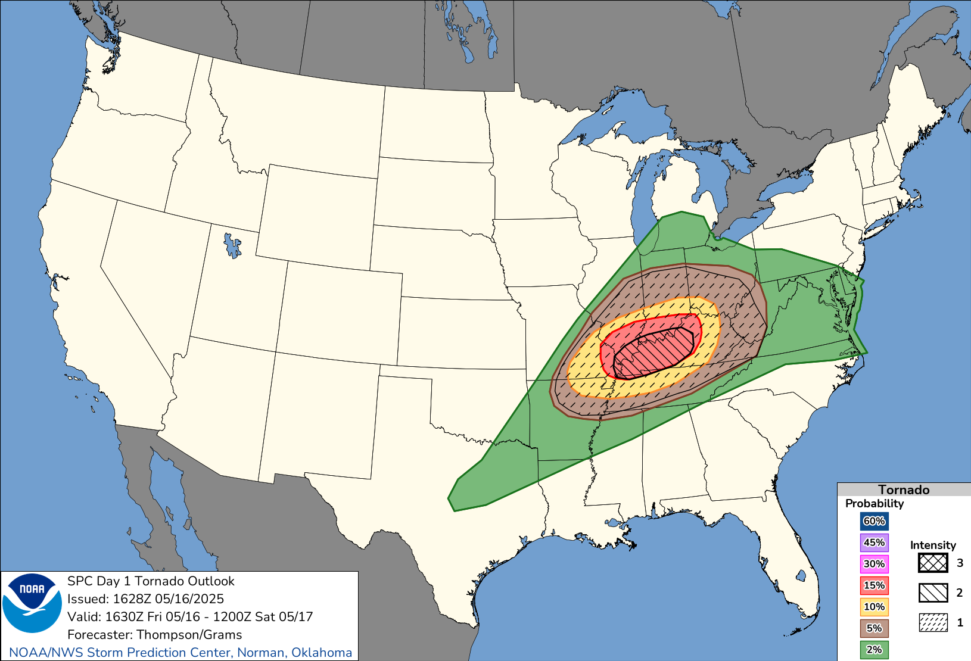
16 May 2025 - Tornado Outlook
Operational
Conditional Intensity
EF2 (In 5% or 2%) EF3 EF4+
Storm Prediction Center
Norman, OK

Slide 28
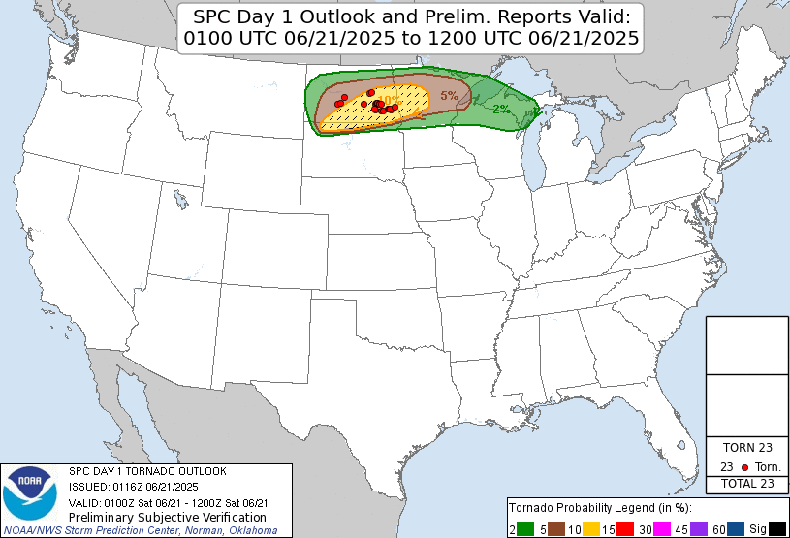
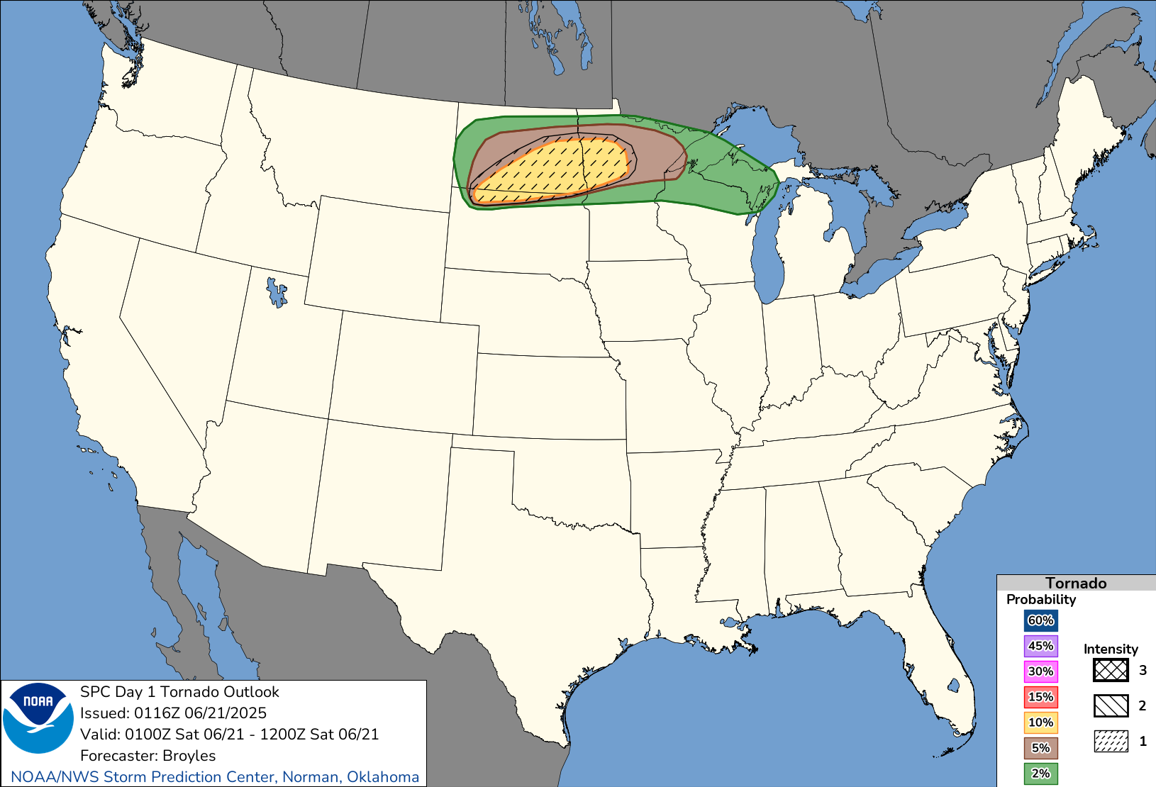
20 June 2025 - Tornado Outlook
Operational
Conditional Intensity
EF2 (In 5% or 2%) EF3 EF4+
Storm Prediction Center
Norman, OK

Slide 29
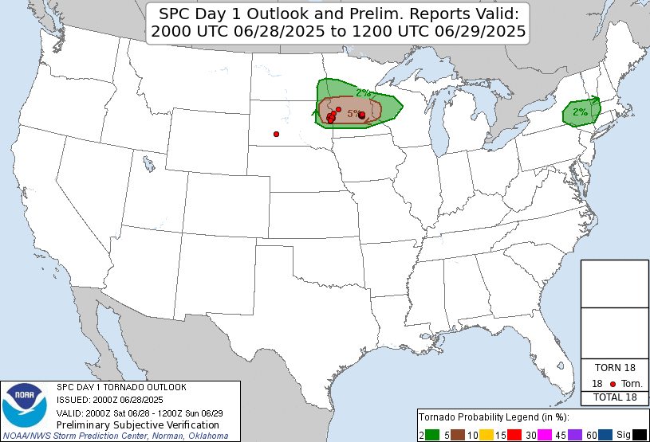
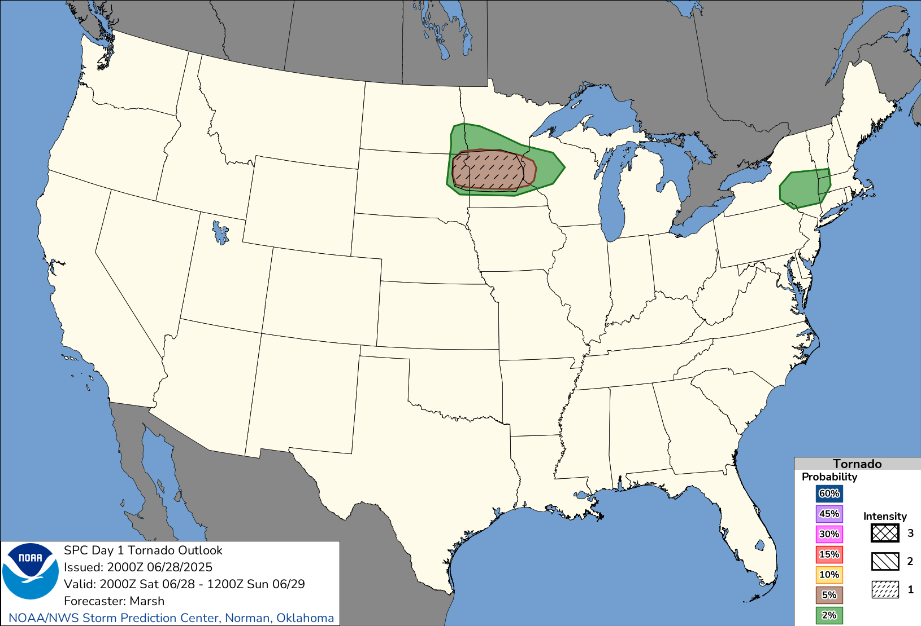
28 June 2025 - Tornado Outlook
Operational
Conditional Intensity
EF2 (In 5% or 2%) EF3 EF4+
Storm Prediction Center
Norman, OK

Slide 30
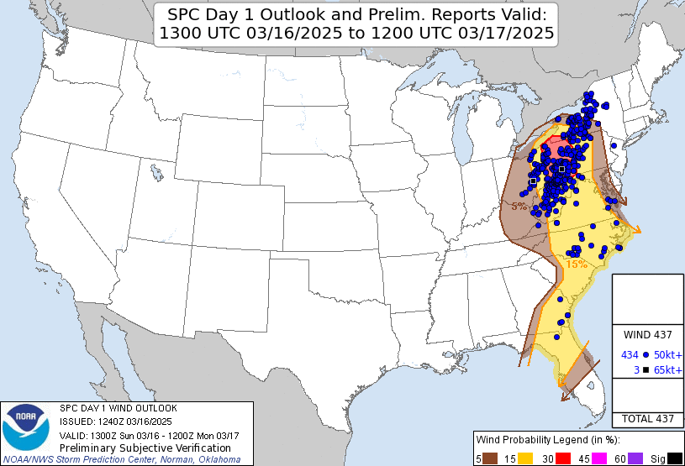
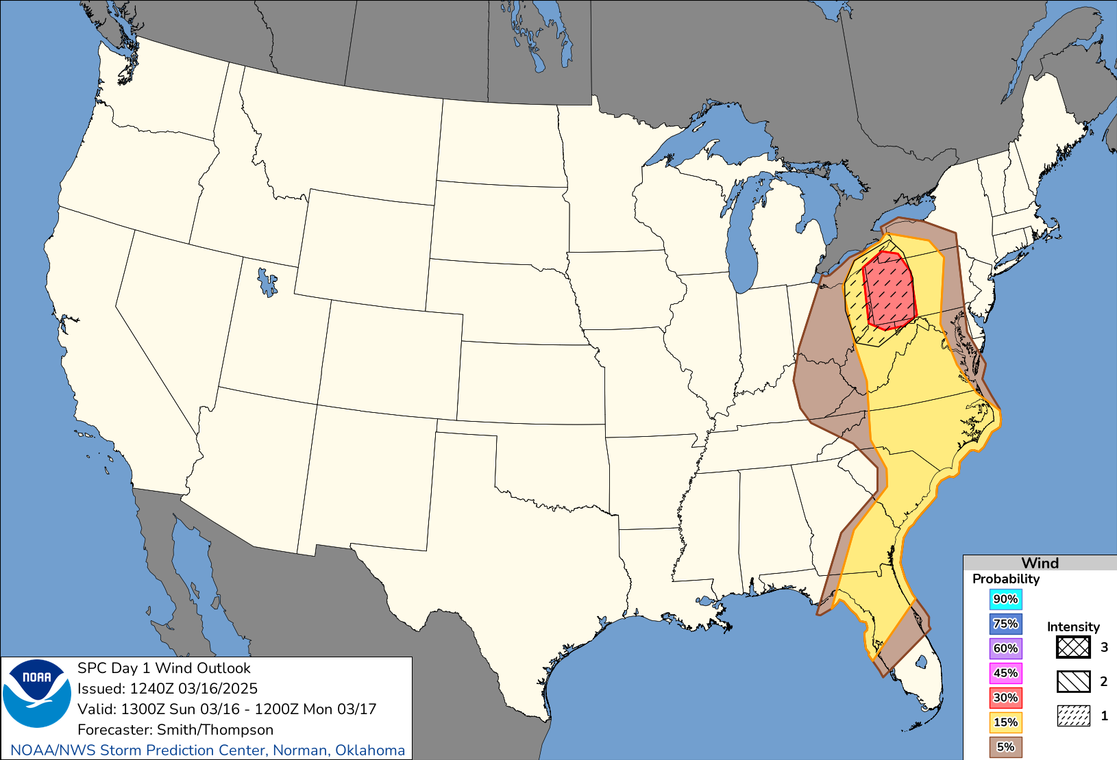
16 March 2025 - Wind Outlook
Operational
Conditional Intensity
64 kts 73 kts 82+ kts
Storm Prediction Center
Norman, OK

Slide 31
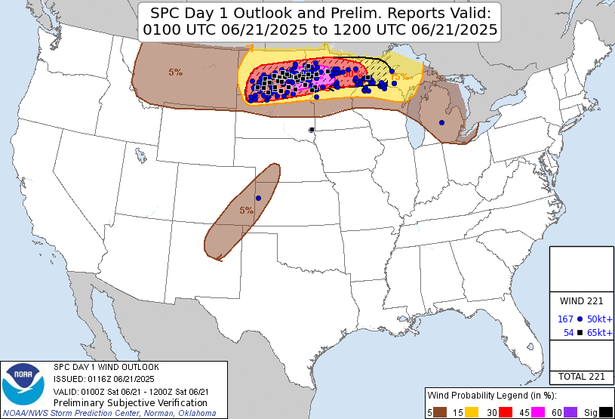
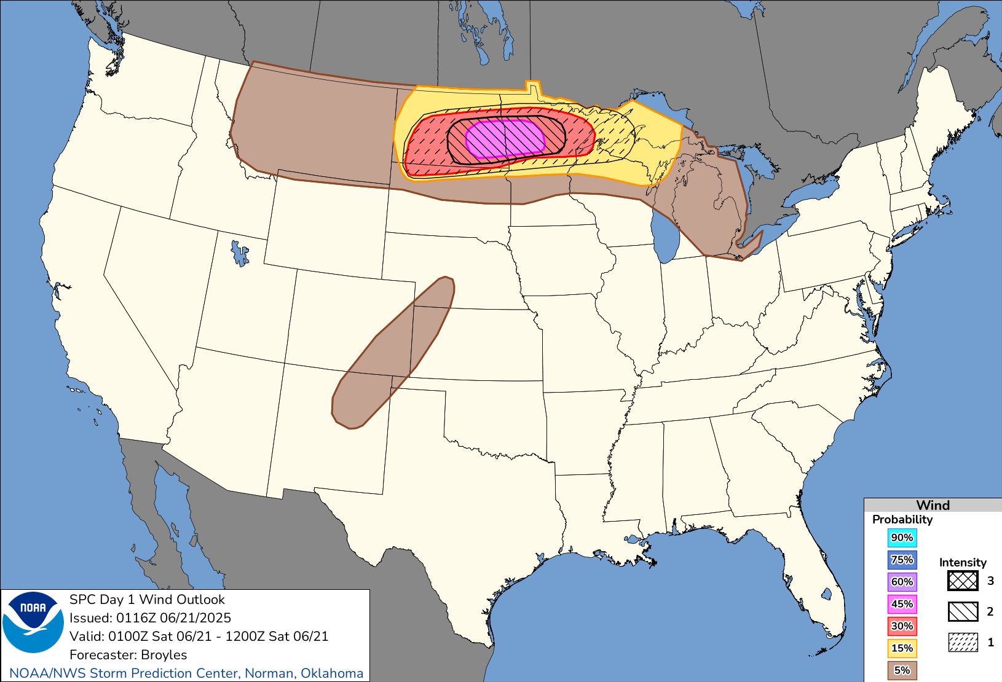
20 June 2025 - Wind Outlook
Operational
Conditional Intensity
64 kts 73 kts 82+ kts
Storm Prediction Center
Norman, OK

Slide 32
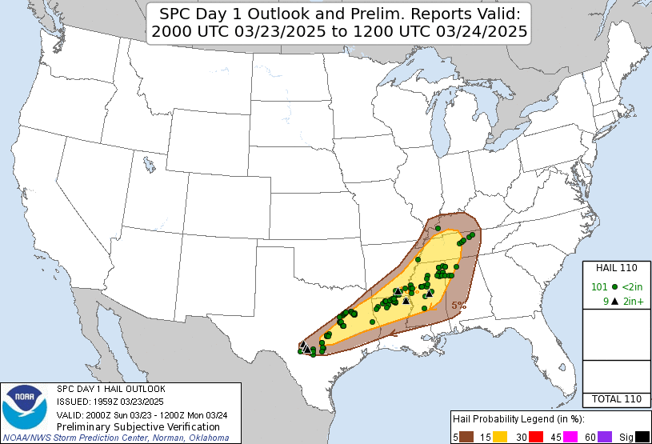
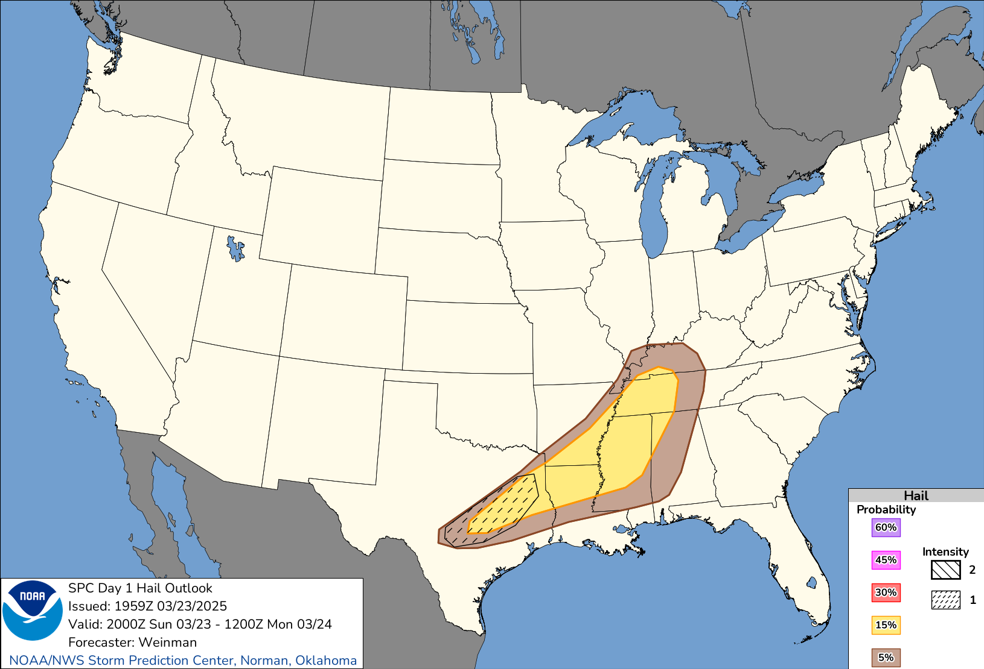
23 March 2025 - Hail Outlook
Operational
Conditional Intensity
2 inch 3.5+ inch
Storm Prediction Center
Norman, OK

Slide 33
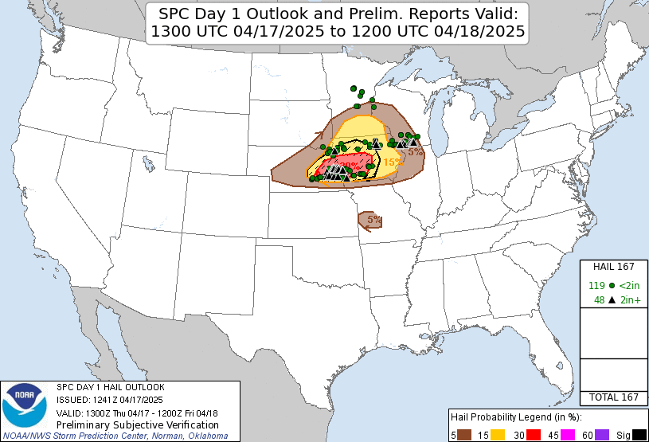
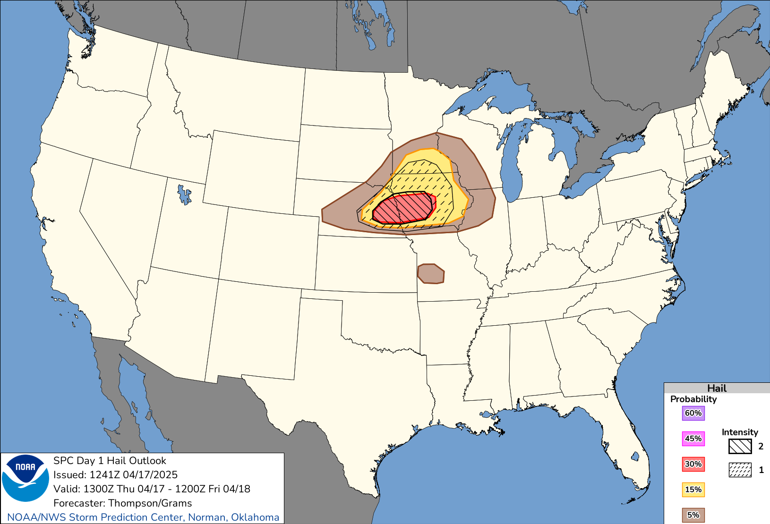
17 April 2025 - Hail Outlook
Operational
Conditional Intensity
2 inch 3.5+ inch
Storm Prediction Center
Norman, OK

Slide 34
Conditional Intensity Outlooks Summary
New Conditional Intensity Scheme not limited to 10% or greater coverage of unconditional probability areas:
Multiple Intensity Tiers
Intensity Level <1: Mostly Weak Tornadoes
Intensity Level 1 : Reasonable Max EF2
Intensity Level 2 : Reasonable Max EF3
Intensity Level 3 : Reasonable Max EF4
Driven by Storm Environment and Convective Mode
Intensity Level 2+ tornado only in high-end environments with supercells
Intensity Level 2+ wind only with an organized MCS
Intensity Level 2 hail only with supercells
Storm Prediction Center
Norman, OK

Slide 35
New Probability-To-Category Conversion Charts
TORNADO (days 1-2) WIND (days 1-2) HAIL (days 1-2) Total SEVERE (day 3)
 |  |  |  |  |  | 90% | 3 ENH | 4 MDT | 5 HIGH | 5 HIGH
 |  |  |  |  |  | 75% | 3 ENH | 4 MDT | 5 HIGH | 5 HIGH
60% | 3 ENH | 5 HIGH | 5 HIGH | 5 HIGH |  | 60% | 3 ENH | 4 MDT | 5 HIGH | 5 HIGH |  | 60% | 3 ENH | 4 MDT | 4 MDT |  | 60% | 3 ENH | 4 MDT | 4 MDT
45% | 3 ENH | 4 MDT | 5 HIGH | 5 HIGH |  | 45% | 3 ENH | 3 ENH | 4 MDT | 5 HIGH |  | 45% | 3 ENH | 3 ENH | 4 MDT |  | 45% | 3 ENH | 3 ENH | 4 MDT
30% | 3 ENH | 4 MDT | 5 HIGH | 5 HIGH |  | 30% | 2 SLGT | 3 ENH | 3 ENH | not used |  | 30% | 2 SLGT | 3 ENH | 3 ENH |  | 30% | 2 SLGT | 3 ENH | 3 ENH
15% | 3 ENH | 3 ENH | 4 MDT | 4 MDT |  | 15% | 2 SLGT | 2 SLGT | 3 ENH | not used |  | 15% | 2 SLGT | 2 SLGT | 3 ENH |  | 15% | 2 SLGT | 2 SLGT | 3 ENH
10% | 2 SLGT | 3 ENH | 3 ENH | 3 ENH |  | 10% | not used | not used | not used | not used |  | 10% | not used | not used | not used |  | 10% | not used | not used | not used
5% | 2 SLGT | 2 SLGT | 3 ENH | not used |  | 5% | 1 MRGL | 1 MRGL | 2 SLGT | not used |  | 5% | 1 MRGL | 1 MRGL | 2 SLGT |  | 5% | 1 MRGL | 1 MRGL | 2 SLGT
2% | 1 MRGL | 1 MRGL | 2 SLGT | not used |  | 2% | not used | not used | not used | not used |  | 2% | not used | not used | not used |  | 2% | not used | not used | not used
 | <CIG1 | CIG1 | CIG2 | CIG3 |  |  | <CIG1 | CIG1 | CIG2 | CIG3 |  |  | <CIG1 | CIG1 | CIG2 |  |  | <CIG1 | CIG1 | CIG2
Storm Prediction Center
Norman, OK

Slide 36
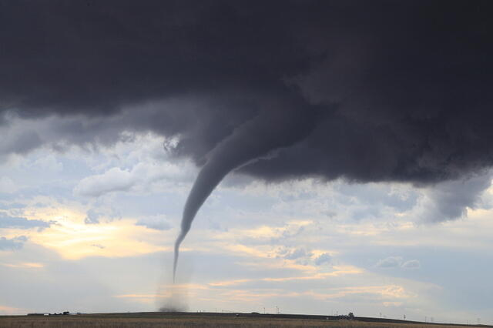
Any Questions?
Contact information:
richard.thompson@noaa.gov
evan.bentley@noaa.gov
Special thanks to:
Israel Jirak (SPC Science and Operations Officer)
Chris Karstens (SPC Senior Development Meteorologist)
Nathan Wendt (SPC Mesoscale-Assistant Forecaster)
Liz Leitman (SPC Mesoscale-Outlook Forecaster)
WFOs OUN, HUN, BOU, PHI, BOI, LSX

